Slide 1

Computer Algorithms
Greedy Algorithms
Siam Sharif Ami
Assistant Lecturer IIUC

Slide 2
Greedy Algorithms
A greedy algorithm always makes the choice that looks best at the moment.
The hope: A locally optimal choice will lead to a globally optimal solution.
For some problems, it works.

Slide 3
What is the largest number that consists of digits 3, 9 , 5, 8, 9 , 1

Slide 4
Greedy Strategy
Find max digit
Append it to the number
Remove it from the list of digits
Repeat while there are digits in the list
Correct Answer: 998531

Slide 5
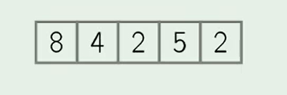
Selection Sort
Find a minimum by scanning the array.
Swap it with the first element.
Repeat with the remaining part of the array.

Slide 6
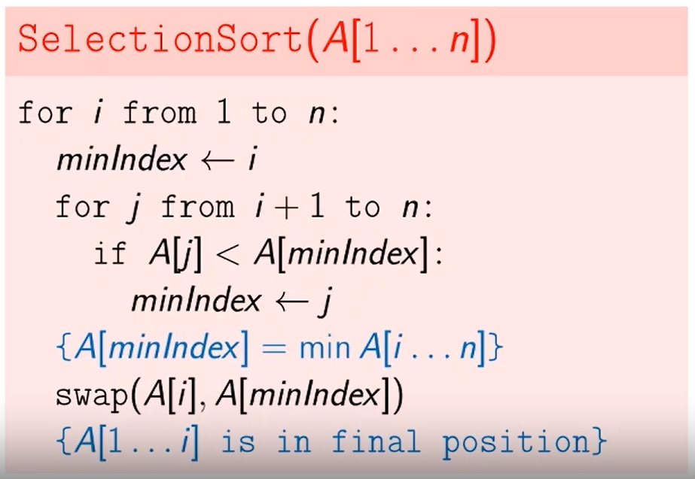
Pseudo Code

Slide 7
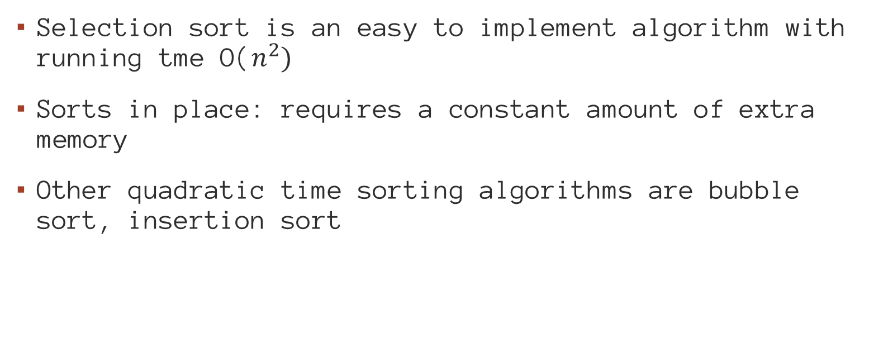
Selection sort
Selection sort is an easy to implement algorithm with running tme O($n^{2})$
Sorts in place: requires a constant amount of extra memory
Other quadratic time sorting algorithms are bubble sort, insertion sort

Slide 8
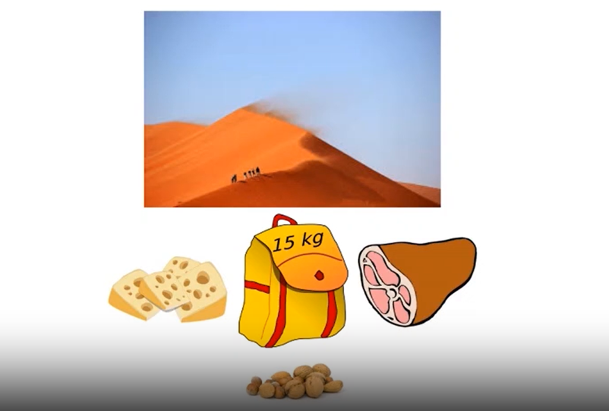
Fractional Knapsack

Slide 9
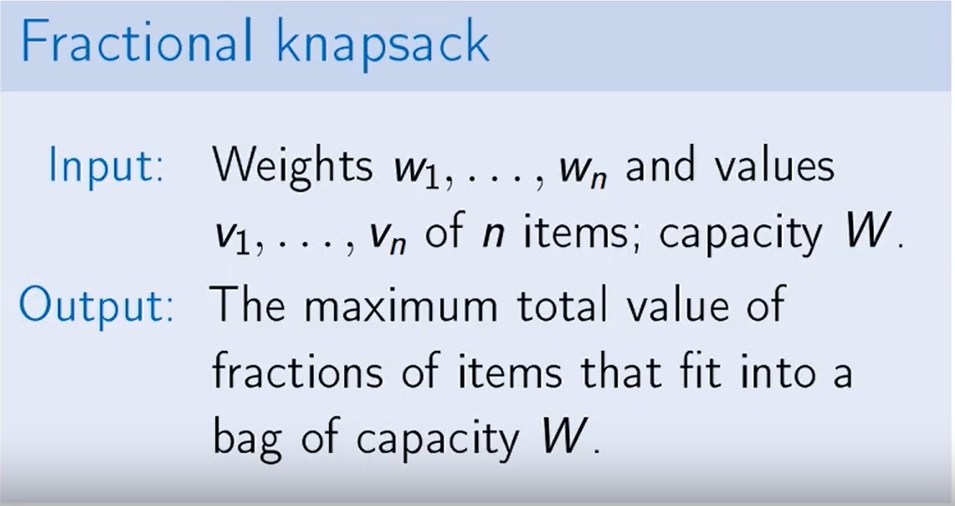

Slide 10
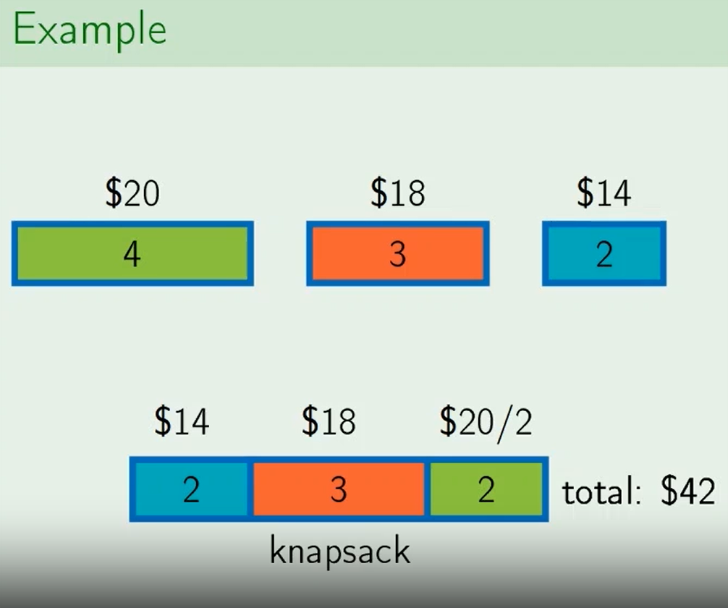
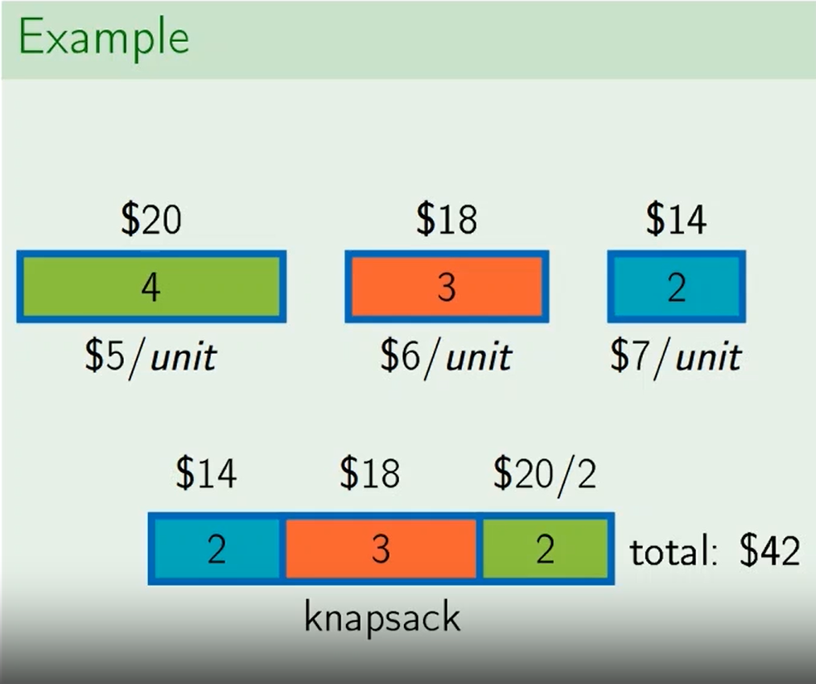
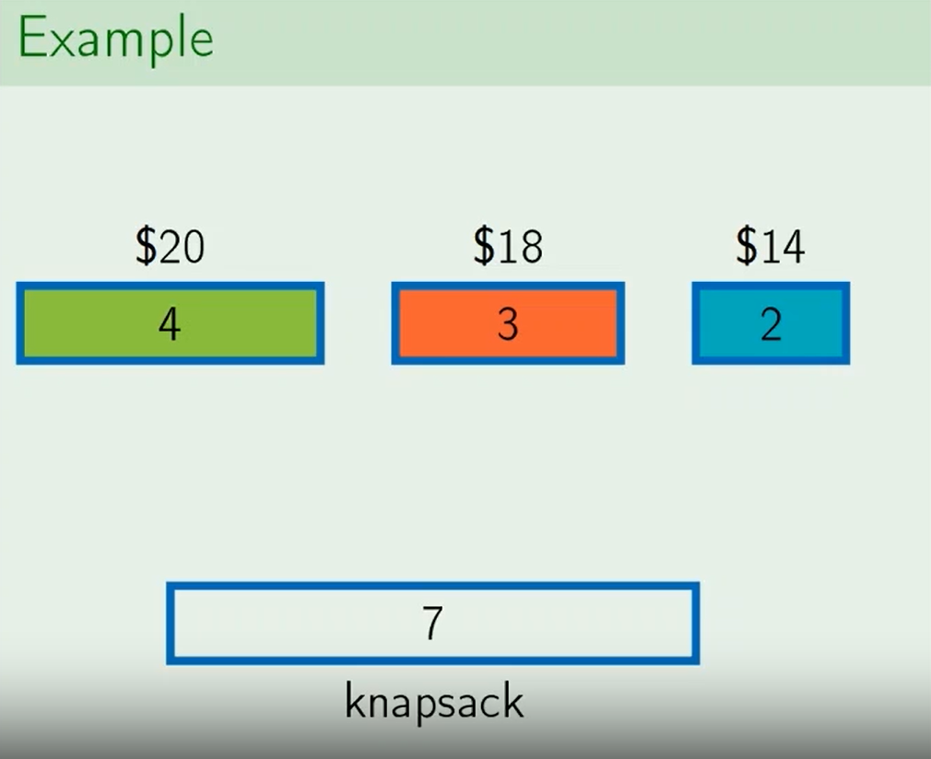
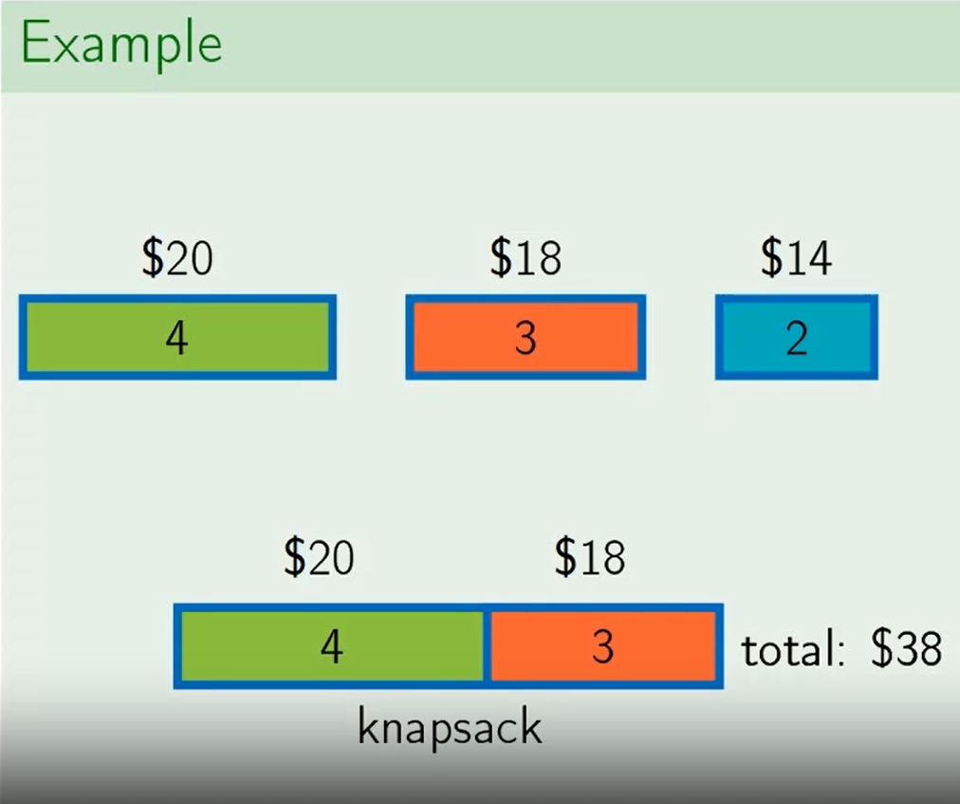
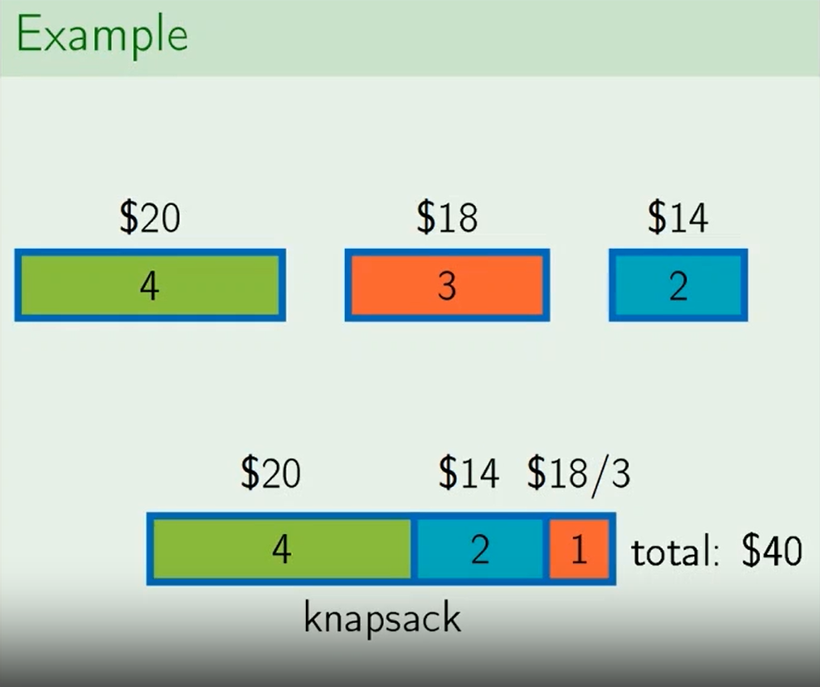
Fractional Knapsack

Slide 11
Greedy Algorithm
While knapsack is not full.
Choose item i with maximum Vi / Wi.
If item fits into knapsack, take all of it.
Otherwise take so much as to fill the knapsack.
Return total value and amounts taken.

Slide 12
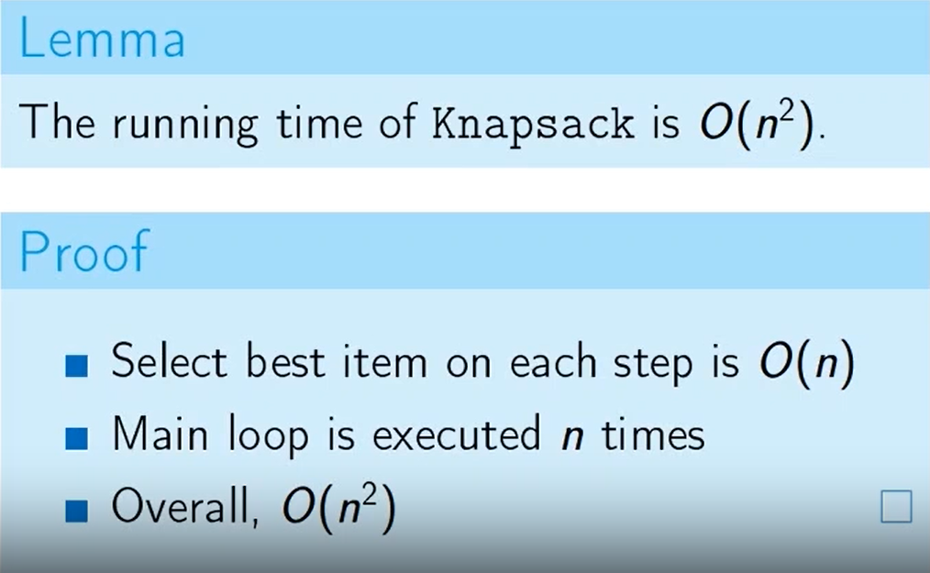
Runtime analysis

Slide 13
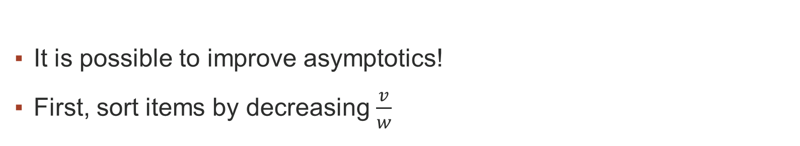
Optimization
It is possible to improve asymptotics!
First, sort items by decreasing $\frac{v}{w}$
Knapsack after sorting is O(n)
Sort + Knapsack is O(nlogn)

Slide 14
Summary of Greedy Algorithms
Safe move
Solve sub problem
Estimate running time

Slide 15
Safe moves
Put max digit first
Select the minimum element
Use item with maximum value per unit of weight.

Slide 16
Optimization
Assume everything is somehow sorted
Which sort order is convenient?
Greedy move can be faster after sorting

Slide 17
Exercise and Home work!
Prove that the fractional knapsack problem has the greedy choice property!

Slide 18
Huffman Codes
Huffman codes compress data very effectively, savings of 0% to 90% are typical depending on the data type being compressed.
Huffman’s greedy algorithm uses a table giving
how often each character occurs (i.e., its frequency) to build up an optimal way of
epresenting each character as a binary string.

Slide 19
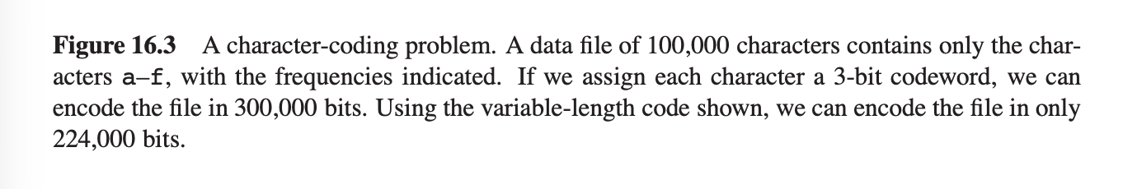
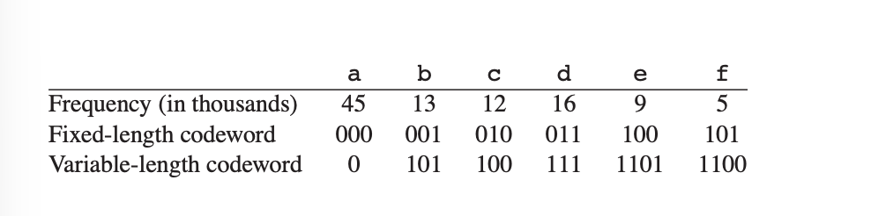
A character- coding problem

Slide 20
Huffman Coding
If we use a fixed-length code, we need 3 bits to represent 6 characters:
a = 000, b = 001, . . . , f = 101. This method requires 300,000 bits to code the entire file.
Can we do better?

Slide 21
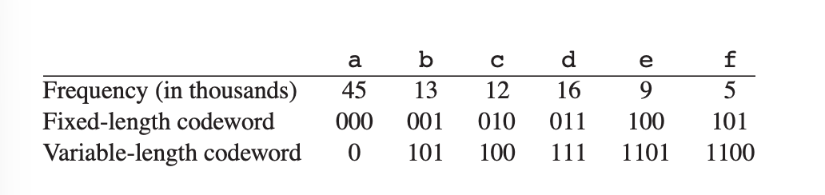
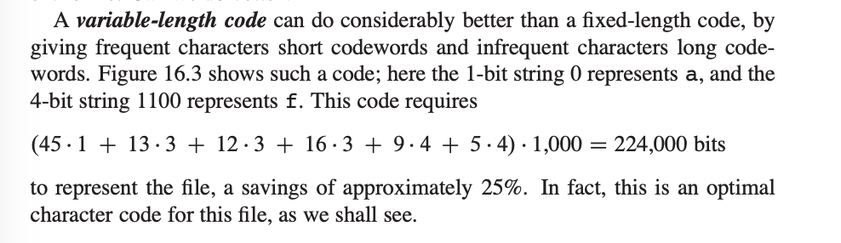
Huffman Coding

Slide 22
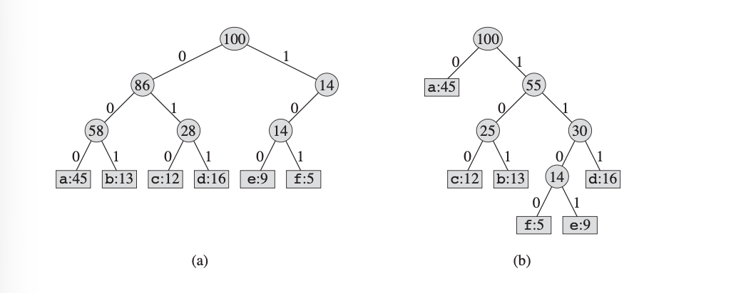
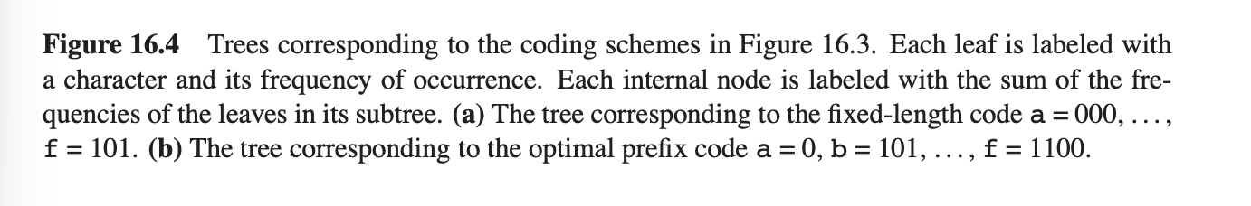

Slide 23
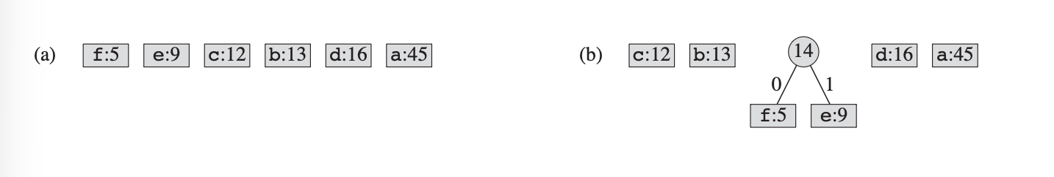
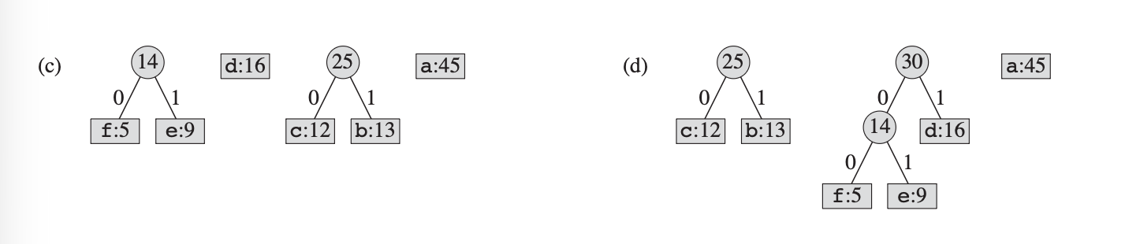
Constructing a Huffman code

Slide 24
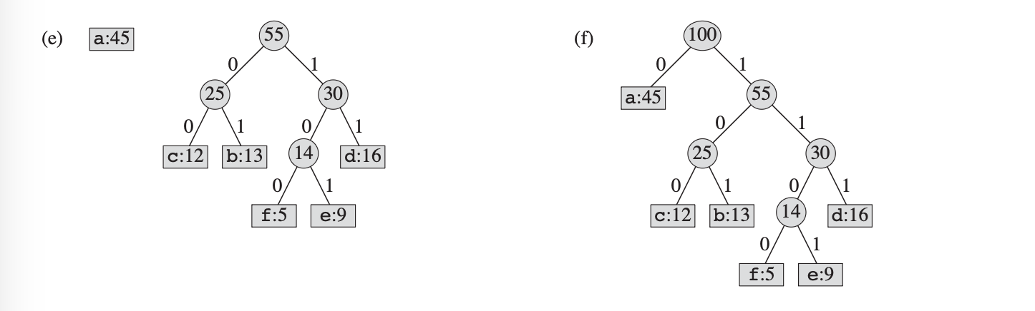
Constructing a Huffman code

Slide 25
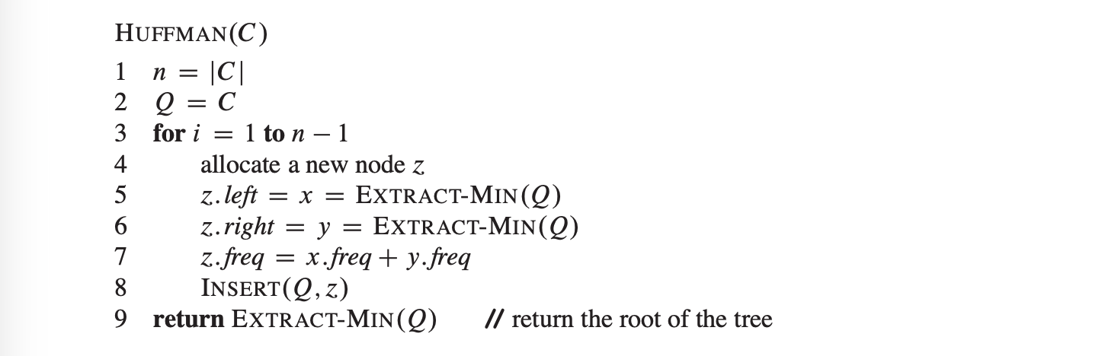
Algorithm

Slide 26
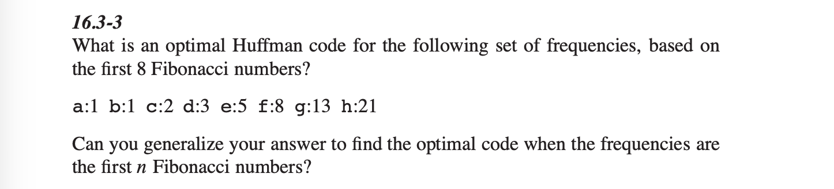
Exercises

Slide 27
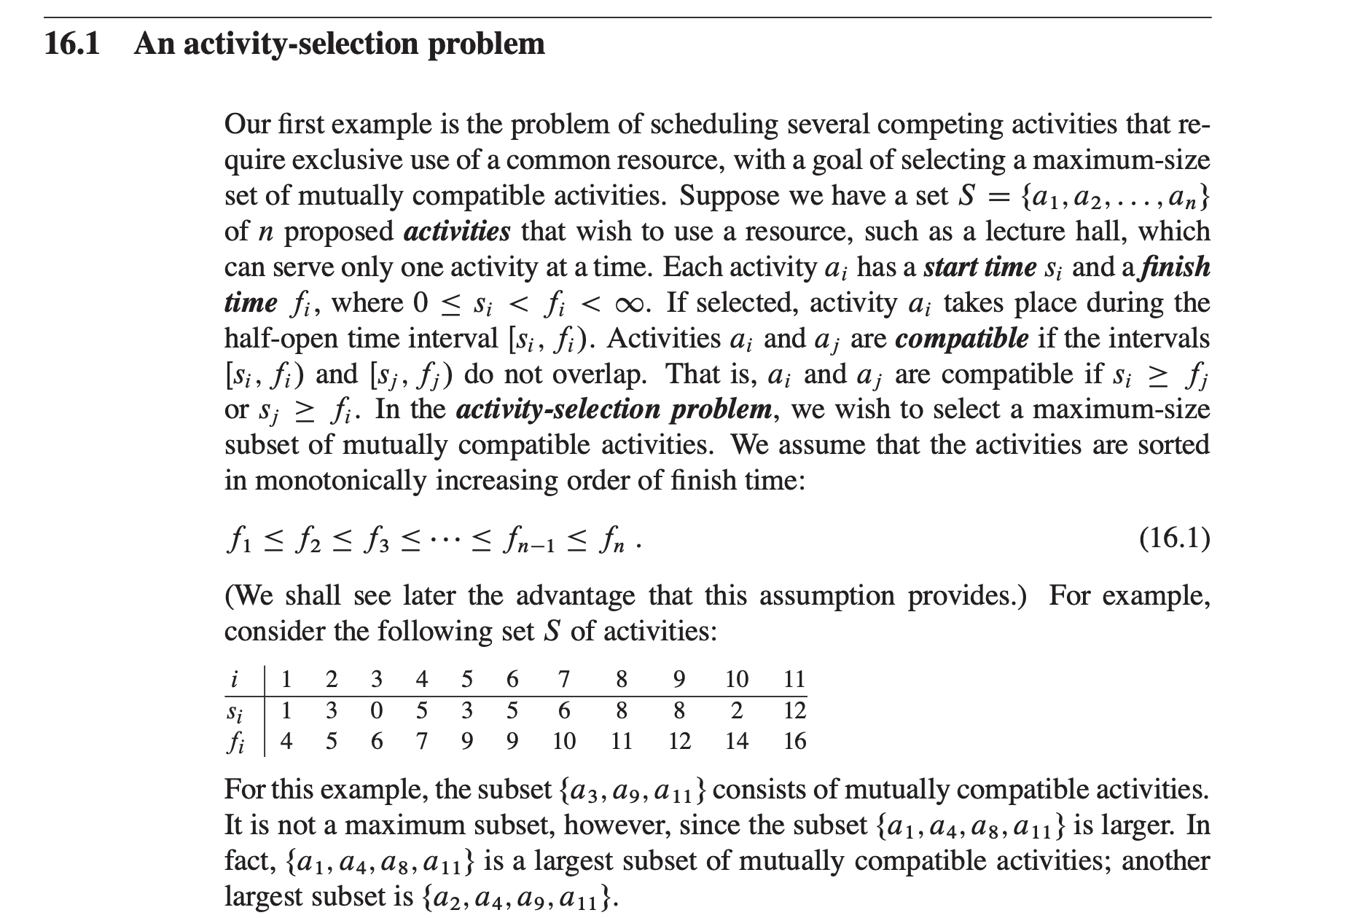

Slide 28
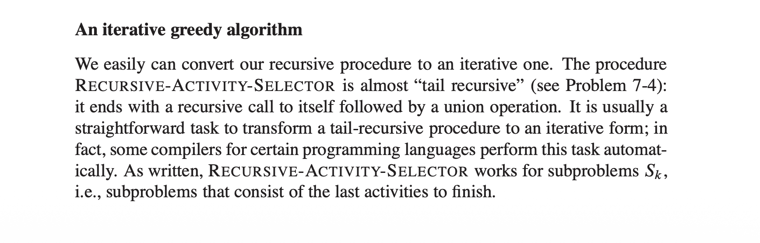

Slide 29
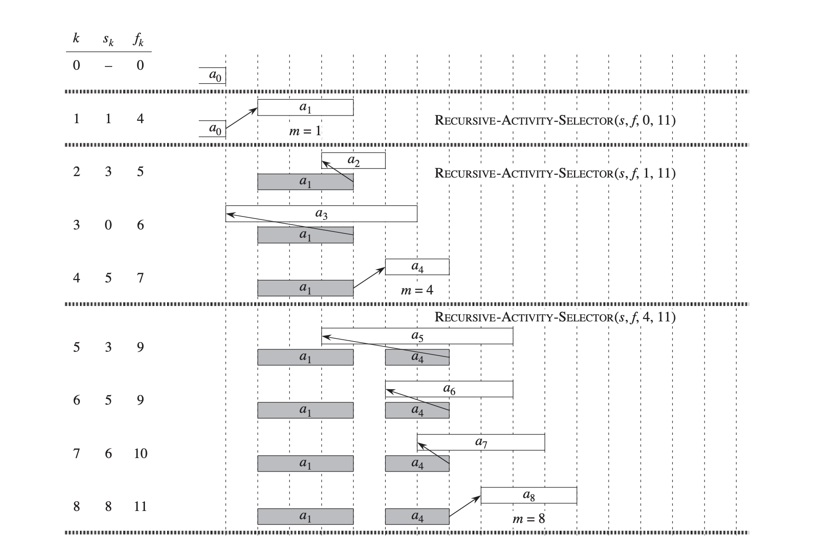

Slide 30
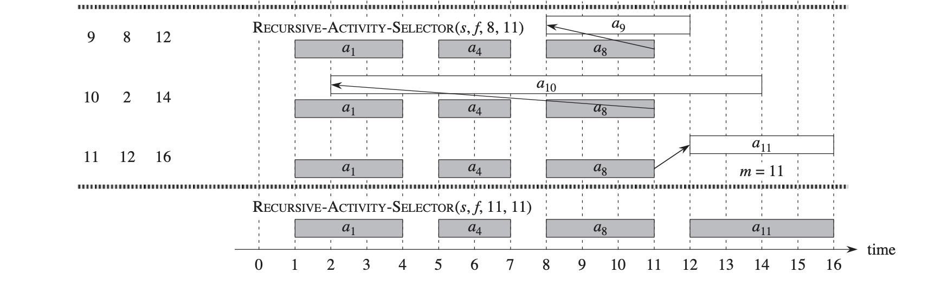

Slide 31
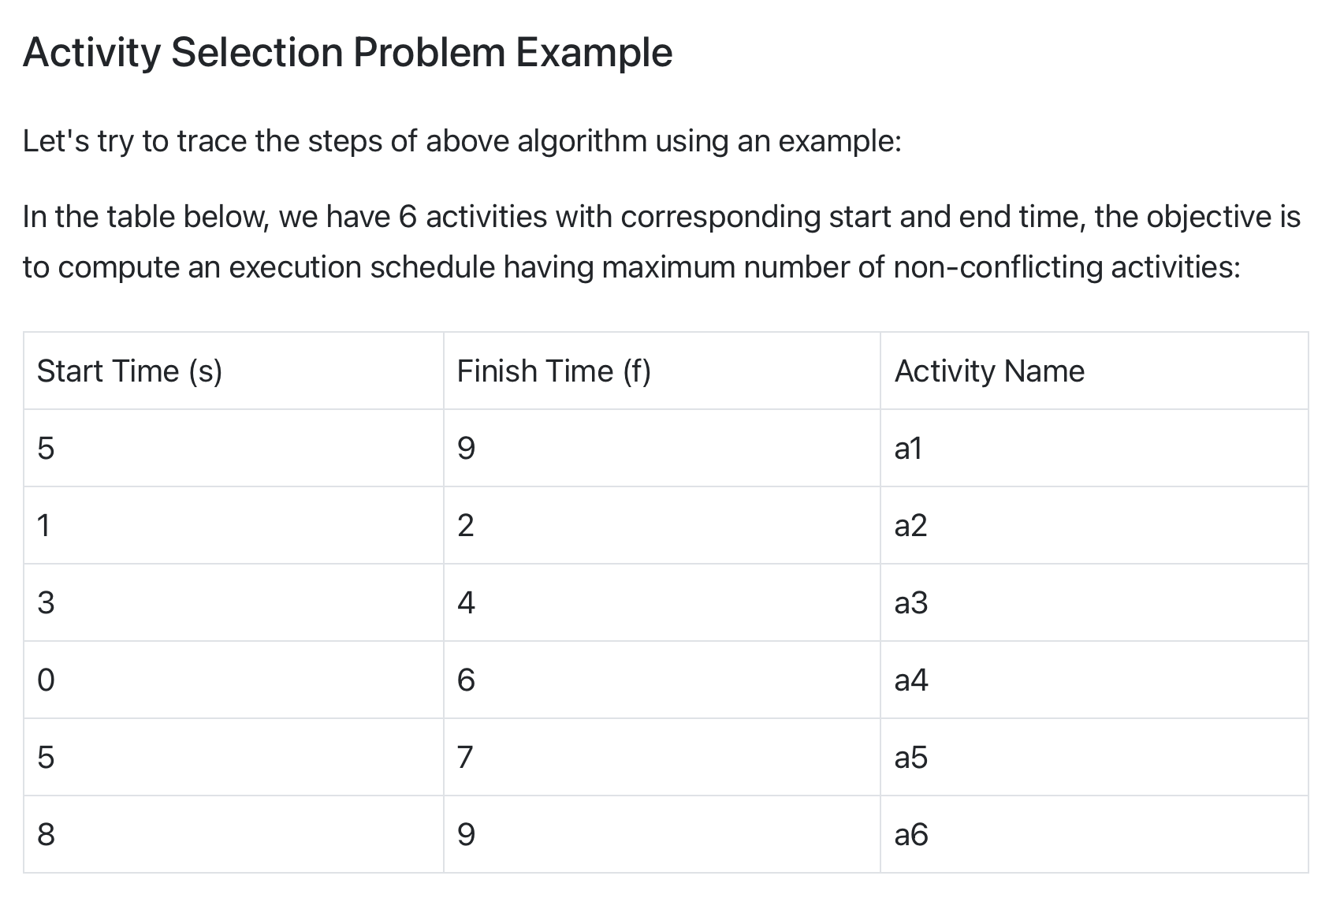

Slide 32
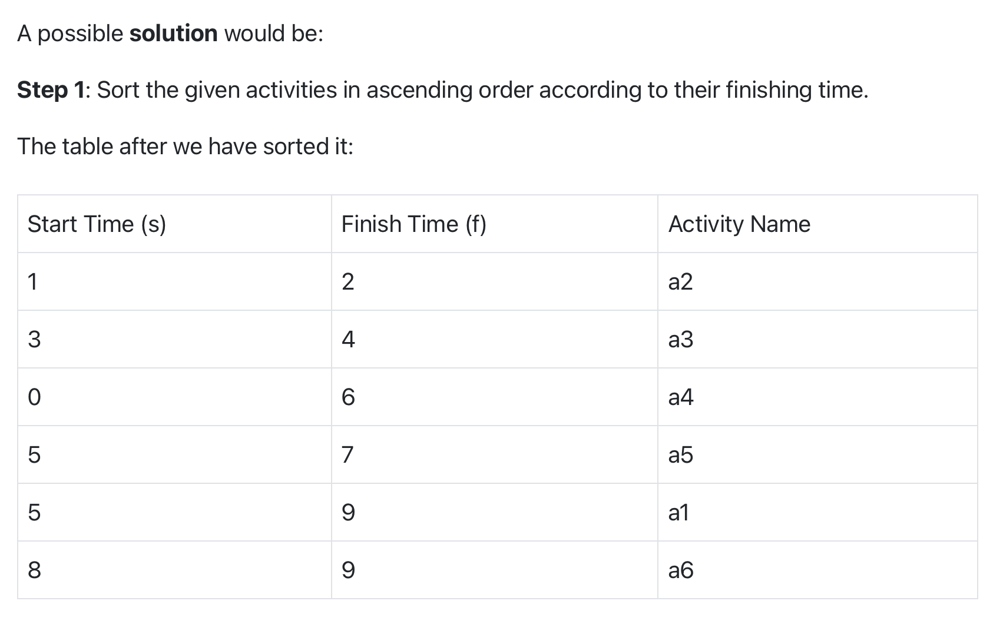

Slide 33
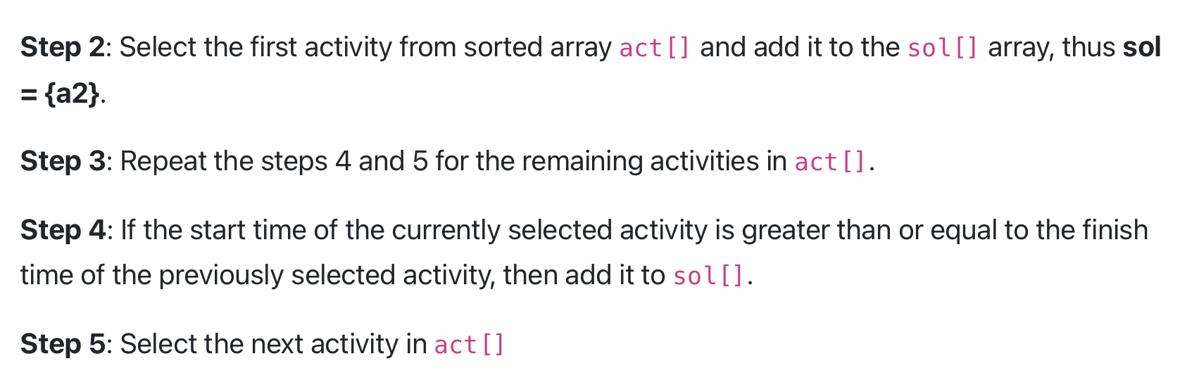

Slide 34
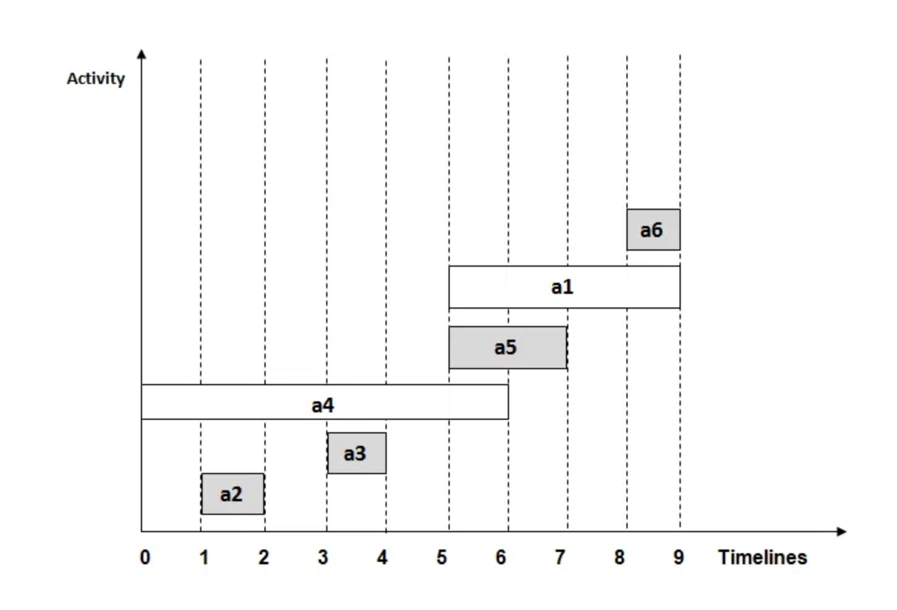

Slide 35
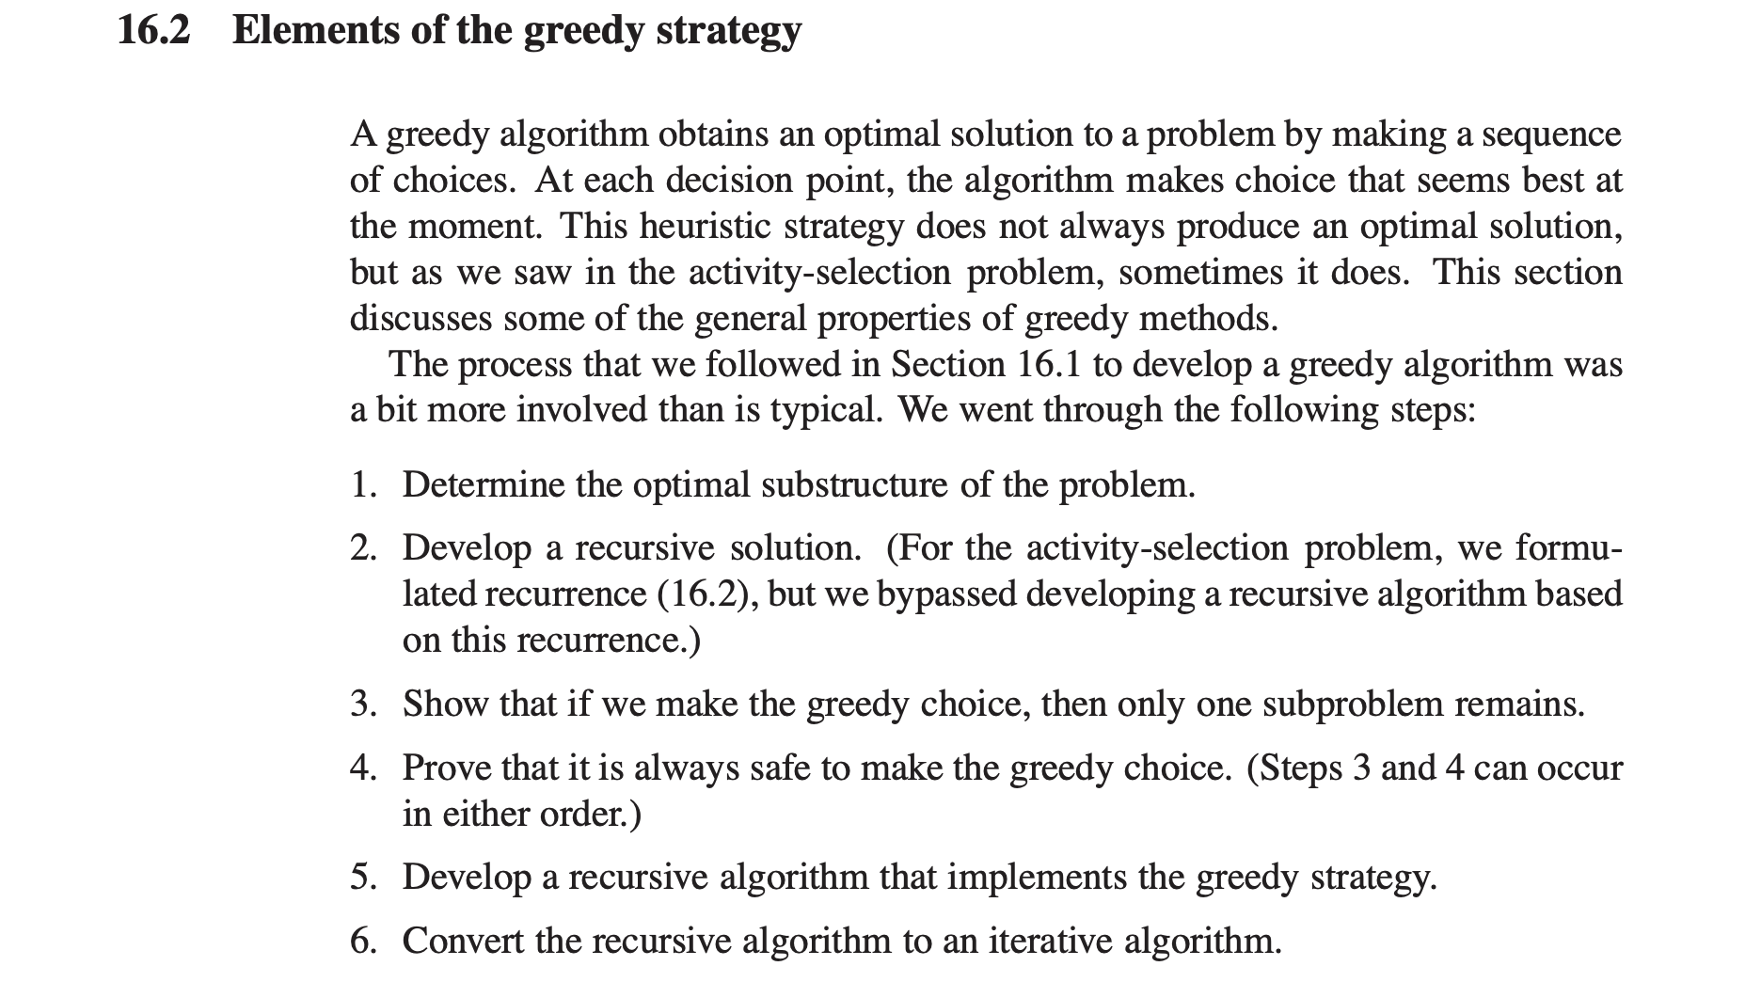

Slide 36

References
Books
Introduction to Algorithms – Thomas H Cormen

